Slide 1
Arithmetic Circuits

Slide 2
Combinational Circuits
Combinational circuit is a circuit in which the different gates are combined in the circuit, for example encoder, decoder, multiplexer and de-multiplexer.
Some of the characteristics of combinational circuits are following −
The output of combinational circuit at any instant of time, depends only on the levels present at input terminals.
The combinational circuit do not use any memory. The previous state of input does not have any effect on the present state of the circuit.
A combinational circuit can have an n number of inputs and m number of outputs.

Slide 3
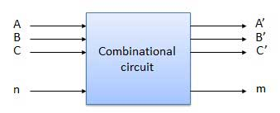
Combinational Circuits
Block diagram

Slide 4
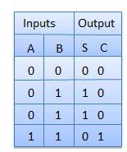
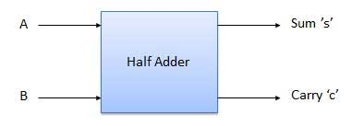
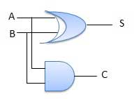
Combinational Circuits
Half Adder
Half adder is a combinational logic circuit with two inputs and two outputs.
The half adder circuit is designed to add two single bit binary number A and B. It is the basic building block for addition of two single bit numbers. This circuit has two outputs carry and sum.
Block diagram Truth Table Circuit Diagram

Slide 5
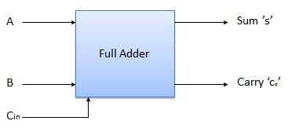
Combinational Circuits
Full Adder
Full adder is developed to overcome the drawback of Half Adder circuit. It can add two one-bit numbers A and B, and carry c.
The full adder is a three input and two output combinational circuit.
Block diagram

Slide 6
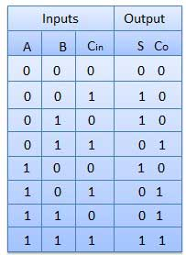
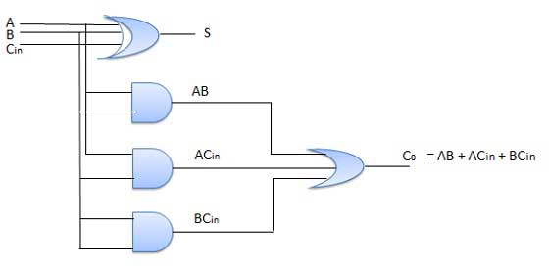
Combinational Circuits
Truth Table Circuit Diagram

Slide 7
Binary Adder & Subtractor

Slide 8
Binary Adder & Subtractor
The most basic arithmetic operation is the addition of two binary digits.
This simple addition consists of four possible elementary
operations: 0 + 0 = 0, 0 + 1 = 1, 1 + 0 = 1, and 1 + 1 = 10.
The first three operations produce a sum of one digit, but when both augend and addend bits are equal to 1, the binary sum consists of two digits.

Slide 9
Binary Adder/Subtractors
The subtraction A-B can be performed by taking the 2's complement of B and adding to A.
The 2's complement of B can be obtained by complementing B and adding one to the result. A-B = A + 2C(B) = A + 1C(B) + 1 = A + B’ + 1

Slide 10
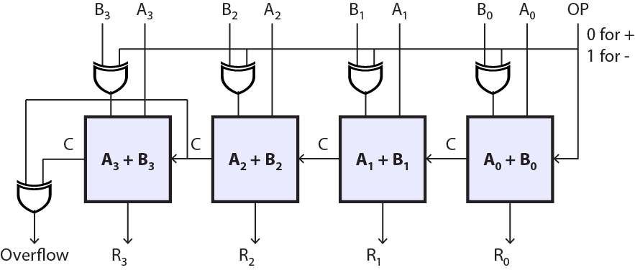
4-bit Binary Adder/Subtractor
ADD/SUB

Slide 11
4-bit Binary Adder/Subtractor (cont.)
When ADD/SUB=0, the circuit performs A + B. The carry in is 0, and the XOR gates simply pass B untouched.
When ADD/SUB =1, the carry into the least significant bit (LSB) is 1, and B is complemented (1’s complement) prior to the addition; hence, the circuit adds to A the 1’s complement of B plus 1 (from the carry into the LSB)
(or)
A - B = A + (2’s complement of B)

Slide 12
4-bit Binary Adder/Subtractor (cont.)
S=0
B₃
B₂
B₁
B₀
0
S=0 selects addition

Slide 13
4-bit Binary Adder/Subtractor (cont.)
S=1
B₃’
B₂’
B₁’
B₀’
1
S=1 selects subtraction

Slide 14
BCD Adder

Slide 15
Binary Codes
The digital data is represented, stored and transmitted as groups of binary bits.
The group of bits is called as binary code.
The binary code represent numbers, alphabets, special characters and control functions.
The codes are classified as
Weighted codes
Non-weighted codes
Error detecting and correcting codes
Alphanumeric codes

Slide 16
Binary Codes

Slide 17
Binary Codes

Slide 18
Conversion and Coding
(12)₁₀

Slide 19
Conversion and Coding
(12)₁₀
1100
Conversion

Slide 20
Conversion and Coding
(12)₁₀
1100
Coding
(using BCD code
for each digit)
00010010
Conversion

Slide 21
BCD Adder
Design a circuit that calculates the
Arithmetic addition of two decimal digits.
9
+
3
1
2
carry

Slide 22
BCD Adder
Maximum sum is 9+9 + 1 = 19
Max digits
Carry from previous digits

Slide 23
BCD adder (sum up to 9)
Number | C | S8 | S4 | S2 | S1
0 | 0 | 0 | 0 | 0 | 0
1 | 0 | 0 | 0 | 0 | 1
2 | 0 | 0 | 0 | 1 | 0
3 | 0 | 0 | 0 | 1 | 1
4 | 0 | 0 | 1 | 0 | 0
5 | 0 | 0 | 1 | 0 | 1
6 | 0 | 0 | 1 | 1 | 0
7 | 0 | 0 | 1 | 1 | 1
8 | 0 | 1 | 0 | 0 | 0
9 | 0 | 1 | 0 | 0 | 1

Slide 24
BCD adder (sum up to 9)
Number | C | S8 | S4 | S2 | S1
0 | 0 | 0 | 0 | 0 | 0
1 | 0 | 0 | 0 | 0 | 1
2 | 0 | 0 | 0 | 1 | 0
3 | 0 | 0 | 0 | 1 | 1
4 | 0 | 0 | 1 | 0 | 0
5 | 0 | 0 | 1 | 0 | 1
6 | 0 | 0 | 1 | 1 | 0
7 | 0 | 0 | 1 | 1 | 1
8 | 0 | 1 | 0 | 0 | 0
9 | 0 | 1 | 0 | 0 | 1
The sum is the same with BCD adder

Slide 25
BCD adder (sum is 10 to 19)
Number | C | S8 | S4 | S2 | S1
10 | 1 | 0 | 0 | 0 | 0
11 | 1 | 0 | 0 | 0 | 1
12 | 1 | 0 | 0 | 1 | 0
13 | 1 | 0 | 0 | 1 | 1
14 | 1 | 0 | 1 | 0 | 0
15 | 1 | 0 | 1 | 0 | 1
16 | 1 | 0 | 1 | 1 | 0
17 | 1 | 0 | 1 | 1 | 1
18 | 1 | 1 | 0 | 0 | 0
19 | 1 | 1 | 0 | 0 | 1

Slide 26
BCD adder (sum is 10 to 19)
BCD adder sum
Binary sum
Number | C | S8 | S4 | S2 | S1
10 | 1 | 0 | 0 | 0 | 0
11 | 1 | 0 | 0 | 0 | 1
12 | 1 | 0 | 0 | 1 | 0
13 | 1 | 0 | 0 | 1 | 1
14 | 1 | 0 | 1 | 0 | 0
15 | 1 | 0 | 1 | 0 | 1
16 | 1 | 0 | 1 | 1 | 0
17 | 1 | 0 | 1 | 1 | 1
18 | 1 | 1 | 0 | 0 | 0
19 | 1 | 1 | 0 | 0 | 1
K | Z8 | Z4 | Z2 | Z1
0 | 1 | 0 | 1 | 0
0 | 1 | 0 | 1 | 1
0 | 1 | 1 | 0 | 0
0 | 1 | 1 | 0 | 1
0 | 1 | 1 | 1 | 0
0 | 1 | 1 | 1 | 1
1 | 0 | 0 | 0 | 0
1 | 0 | 0 | 0 | 1
1 | 0 | 0 | 1 | 0
1 | 0 | 0 | 1 | 1

Slide 27
BCD adder (sum is 10 to 19)
BCD adder sum
Binary sum
Number | C | S8 | S4 | S2 | S1
10 | 1 | 0 | 0 | 0 | 0
11 | 1 | 0 | 0 | 0 | 1
12 | 1 | 0 | 0 | 1 | 0
13 | 1 | 0 | 0 | 1 | 1
14 | 1 | 0 | 1 | 0 | 0
15 | 1 | 0 | 1 | 0 | 1
16 | 1 | 0 | 1 | 1 | 0
17 | 1 | 0 | 1 | 1 | 1
18 | 1 | 1 | 0 | 0 | 0
19 | 1 | 1 | 0 | 0 | 1
K | Z8 | Z4 | Z2 | Z1
0 | 1 | 0 | 1 | 0
0 | 1 | 0 | 1 | 1
0 | 1 | 1 | 0 | 0
0 | 1 | 1 | 0 | 1
0 | 1 | 1 | 1 | 0
0 | 1 | 1 | 1 | 1
1 | 0 | 0 | 0 | 0
1 | 0 | 0 | 0 | 1
1 | 0 | 0 | 1 | 0
1 | 0 | 0 | 1 | 1

Slide 28
BCD adder (sum is 10 to 19)
BCD adder sum
Binary sum
Number | C | S8 | S4 | S2 | S1
10 | 1 | 0 | 0 | 0 | 0
11 | 1 | 0 | 0 | 0 | 1
12 | 1 | 0 | 0 | 1 | 0
13 | 1 | 0 | 0 | 1 | 1
14 | 1 | 0 | 1 | 0 | 0
15 | 1 | 0 | 1 | 0 | 1
16 | 1 | 0 | 1 | 1 | 0
17 | 1 | 0 | 1 | 1 | 1
18 | 1 | 1 | 0 | 0 | 0
19 | 1 | 1 | 0 | 0 | 1
K | Z8 | Z4 | Z2 | Z1
0 | 1 | 0 | 1 | 0
0 | 1 | 0 | 1 | 1
0 | 1 | 1 | 0 | 0
0 | 1 | 1 | 0 | 1
0 | 1 | 1 | 1 | 0
0 | 1 | 1 | 1 | 1
1 | 0 | 0 | 0 | 0
1 | 0 | 0 | 0 | 1
1 | 0 | 0 | 1 | 0
1 | 0 | 0 | 1 | 1
+6

Slide 29
Algorithm for BCD Adder
Add two numbers using ordinary binary addition.
If sum is equal to or less than 9, no correction is needed and the sum is in correct BCD form.
Use the regular Adder.
If the sum > 9 or if carry is generated from the result, the result is invalid and the correction is needed.
Use the regular adder and add 6 (0110) to the result

Slide 30
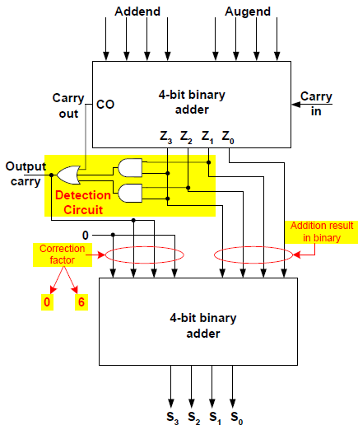
BCD Adder

Slide 31
Data Processing Circuits Multiplexers & De-Multiplexers

Slide 32
MULTIPLEXERS
A multiplexers (MUX) is a device that allows digital information from several sources to be routed onto a single line for transmission that line to a common destination.
The basic multiplexers has several data input lines and a single output line.
MUX is also called as data selector because the output bit depends on the input data bit that is selected.

Slide 33
Functional diagram of MUX

Slide 34
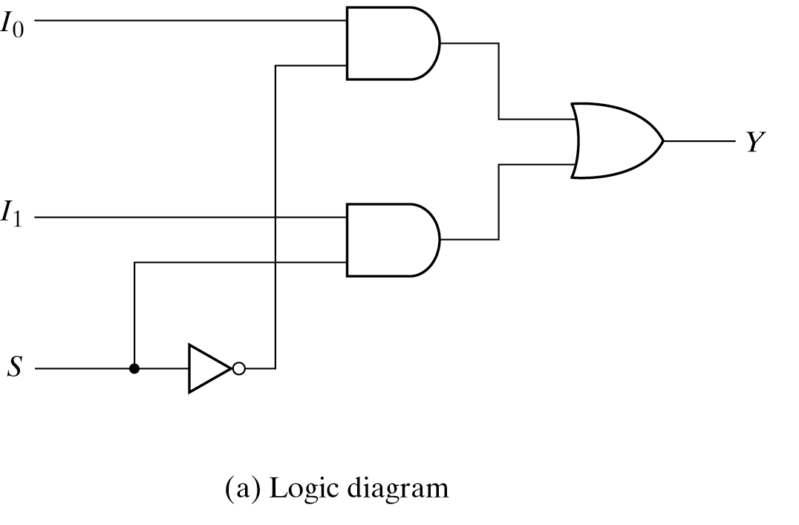
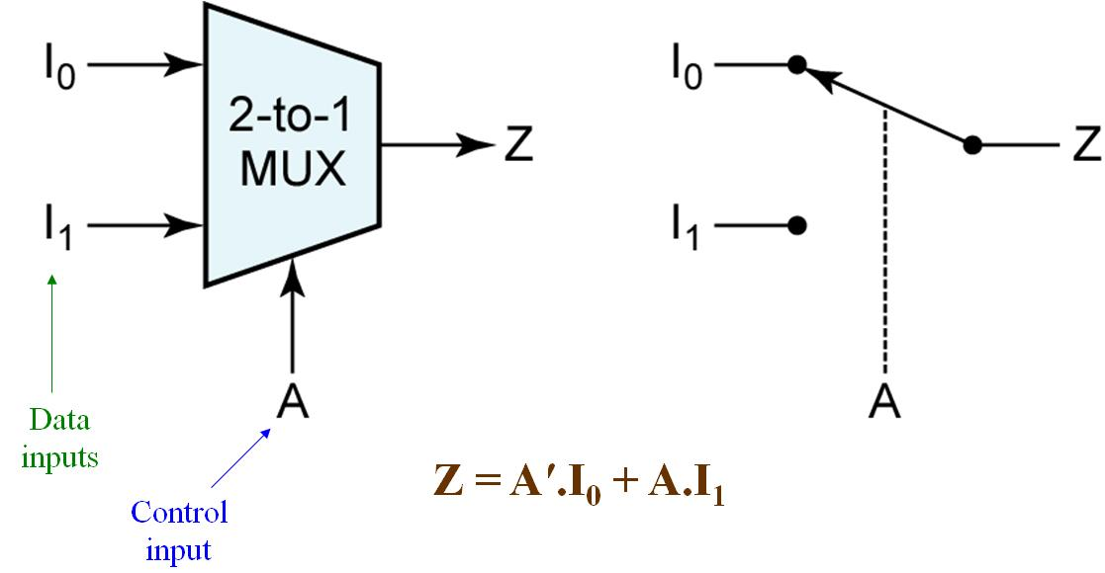
2x1 multiplexer

Slide 35
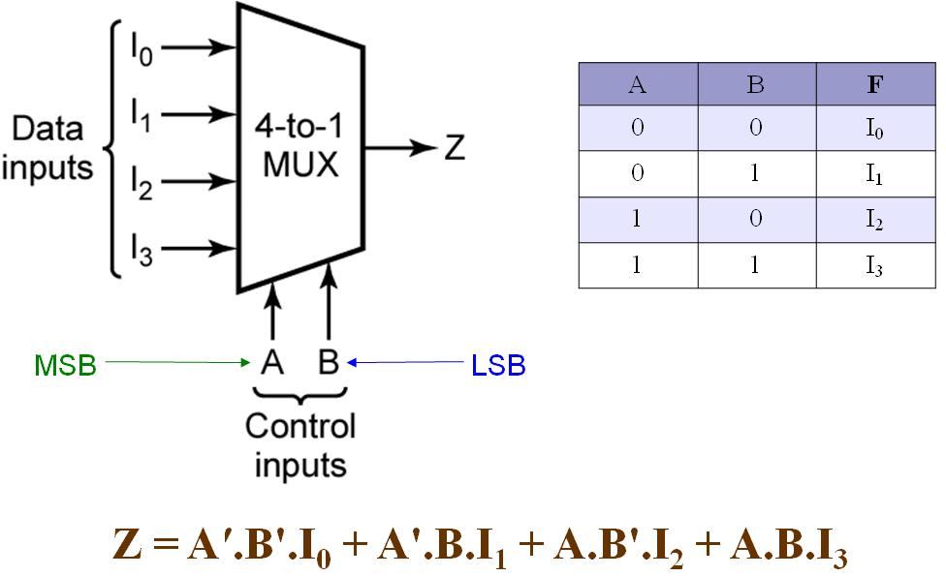
Four-to-One Line multiplexer

Slide 36
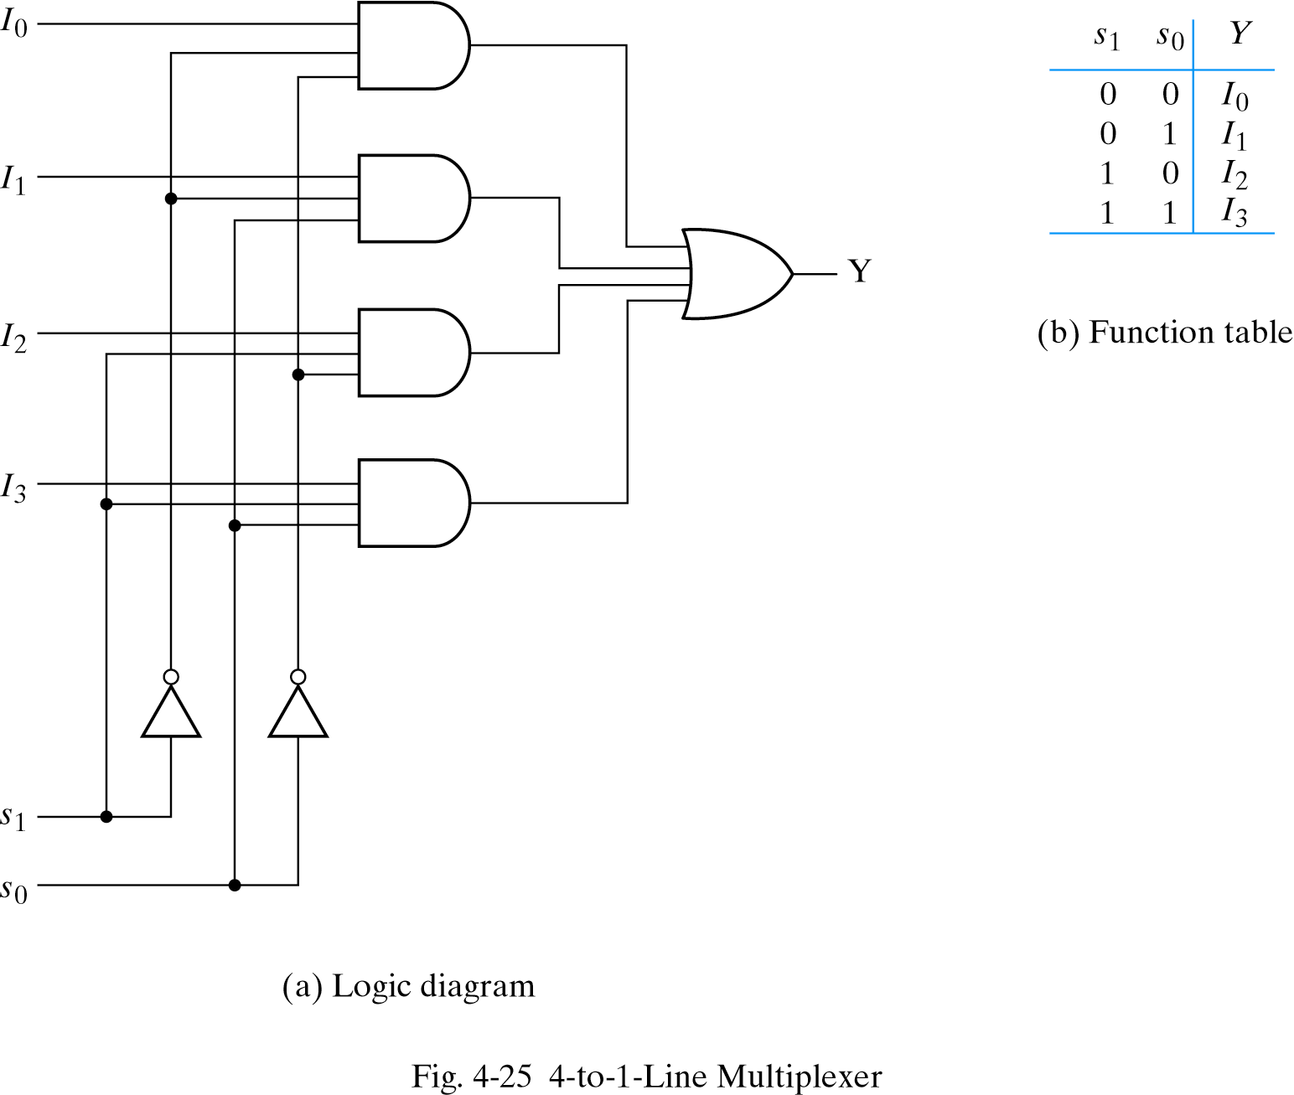
4x1 Multiplexer

Slide 37
8x1 Multiplexer
A | B | C | F
0 | 0 | 0 | I₀
0 | 0 | 1 | I₁
0 | 1 | 0 | I₂
0 | 1 | 1 | I₃
1 | 0 | 0 | I₄
1 | 0 | 1 | I₅
1 | 1 | 0 | I₆
1 | 1 | 1 | I₇
MSB
LSB
Z = A′.B'.C'.I₀ + A'.B'.C.I₁ + A'.B.C'.I₂ + A'.B.C.I₃ +
A.B'.C'.I₀ + A.B'.C.I₁ + A'.B.C'.I₂ + A.B.C.I₃
37

Slide 38
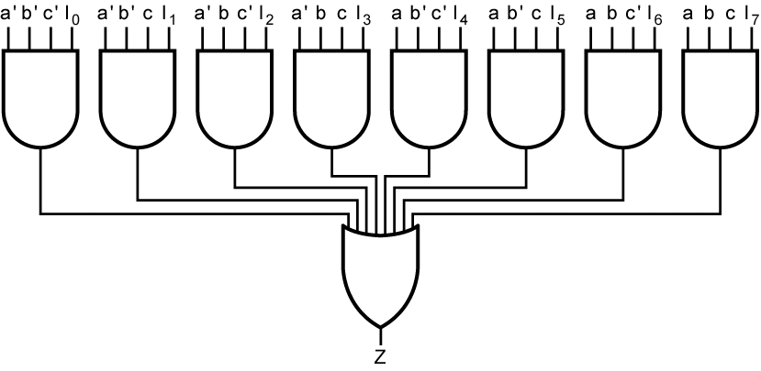
8x1 Multiplexer

Slide 39
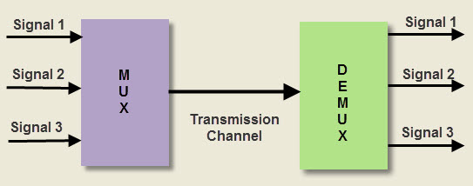
Demultiplexers
De-multiplexer means “one into many”.
It is a combinational logic circuit with one input and many outputs.
A demultiplexer has
1 data input, N control inputs, 2^{N} outputs
A demultiplexer routes (or connects) the data input to the selected output.
The value of the control inputs determines the output that is selected.
A demultiplexer performs the opposite function of a multiplexer.

Slide 40
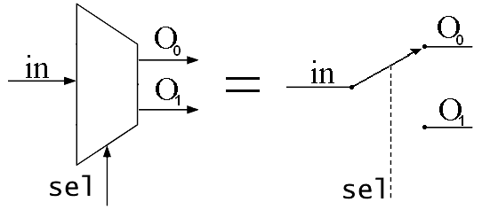
Demultiplexers

Slide 41
De-multiplexers
Out₀
W
W = A'.B'.I
Out₁
X
X = A.B'.I
I
In
Y
Out₂
Z
Y = A'.B.I
Out₃
S₁
S₀
Z = A.B.I
A
B
A | B | W | X | Y | Z
0 | 0 | I | 0 | 0 | 0
0 | 1 | 0 | I | 0 | 0
1 | 0 | 0 | 0 | I | 0
1 | 1 | 0 | 0 | 0 | I

Slide 42
Decoders

Slide 43
Decoders
Decoder is a combinational circuit that decodes the information on N input lines to a max. of 2^{N} output lines
A decoder is a logic circuit that accepts a set of inputs that represents a binary number and activates only the output that corresponds to the input number.
In other words, a decoder circuit looks at its inputs, determines which binary number is present there, and activates the one output that corresponds to that number ; all other outputs remain inactive.
A decoder has N inputs & 2^{N} outputs
A decoder selects one of 2^{N} outputs by decoding the binary value on the N inputs.
Converting from Binary to Decimal is called Decode.

Slide 44
Decoders
W = A'.B'
Out₀
W
B
I₀
Out₁
X
X = A.B'
A
I₁
Out₂
Y
Y = A'.B
Out₃
Z
msb
Z = A.B
Active-high outputs
A | B | W | X | Y | Z
0 | 0 | 1 | 0 | 0 | 0
0 | 1 | 0 | 1 | 0 | 0
1 | 0 | 0 | 0 | 1 | 0
1 | 1 | 0 | 0 | 0 | 1

Slide 45
Decoders
W = (A'.B')'
Out₀
W
B
I₀
Out₁
X
X = (A.B')'
A
I₁
Out₂
Y
Y = (A'.B)'
Out₃
Z
msb
Z = (A.B)'
Active-low outputs
A | B | W | X | Y | Z
0 | 0 | 0 | 1 | 1 | 1
0 | 1 | 1 | 0 | 1 | 1
1 | 0 | 1 | 1 | 0 | 1
1 | 1 | 1 | 1 | 1 | 0

Slide 46
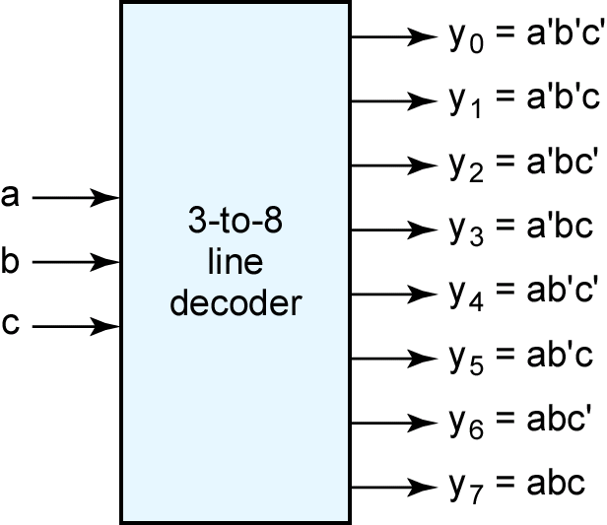
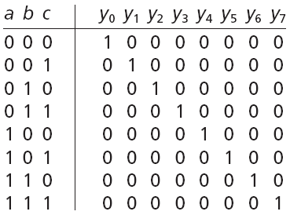
Decoders
msb

Slide 47
Decoder with Enable
Out₀
W
B
I₀
high-level
enable
Out₁
X
A
I₁
Y
Out₂
Out₃
Z
Enable
En
En | A | B | W | X | Y | Z
1 | 0 | 0 | 1 | 0 | 0 | 0
1 | 0 | 1 | 0 | 1 | 0 | 0
1 | 1 | 0 | 0 | 0 | 1 | 0
1 | 1 | 1 | 0 | 0 | 0 | 1
0 | x | x | 0 | 0 | 0 | 0
enabled
disabled

Slide 48
Decoder with Enable
Out₀
W
B
I₀
low-level
enable
Out₁
X
A
I₁
Y
Out₂
Out₃
Z
Enable
En
En | A | B | W | X | Y | Z
0 | 0 | 0 | 1 | 0 | 0 | 0
0 | 0 | 1 | 0 | 1 | 0 | 0
0 | 1 | 0 | 0 | 0 | 1 | 0
0 | 1 | 1 | 0 | 0 | 0 | 1
1 | x | x | 0 | 0 | 0 | 0
enabled
disabled

Slide 49
Decoder
Decoders are used in many types of applications. One example is in computers for I/O selection.
Computer must communicate with a variety of external devices called peripherals by sending and/or receiving data through what is known as input/output (I/O) ports
Each I/O port has a number, called an address, which uniquely identifies it. When the computer wants to communicate with a particular device, it issues the appropriate address code for the I/O port to which that particular device is connected.
The binary port address is decoded and appropriate decoder output is activated to enable the I/O port.
Binary data are transferred within the computer on a data bus through a set of parallel lines.

Slide 50
Encoders

Slide 51
Encoder
An encoder is a combinational logic circuit that essentially performs a “reverse” of decoder functions.
An encoder has 2^{N} inputs and N outputs.
An encoder accepts an active level on one of its inputs, representing digit, such as a decimal or octal digits, and converts it to a coded output such as BCD or binary.
Encoders can also be devised to encode various symbols and alphabetic characters.
Converting from Decimal to Binary is called Encode.
The process of converting from familiar symbols or numbers to a coded format is called encoding.

Slide 52
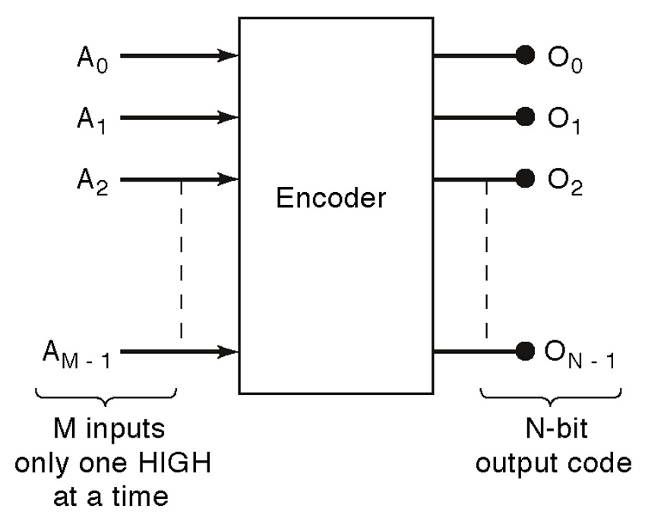
Encoder Design

Slide 53
Encoders
D
I₀
C
I₁
Out₀
Z
Out₁
Y
B
I₂
A
I₃
A | B | C | D | Y | Z
0 | 0 | 0 | 1 | 0 | 0
0 | 0 | 1 | 0 | 0 | 1
0 | 1 | 0 | 0 | 1 | 0
1 | 0 | 0 | 0 | 1 | 1

Slide 54
Multiplexer Vs Encoder
A multiplexer or MUX is a combination circuit that contains more than one input line, one output line and more than one selection line.
Whereas, an encoder is also considered a type of multiplexer but without a single output line.
It is a combinational logic function that has 2^{N} input lines and N output lines.

Slide 55
Thank You

